Slide 1
Mercy
What does it mean, where do we find it in the Bible…
…and how do we live it?

Slide 2
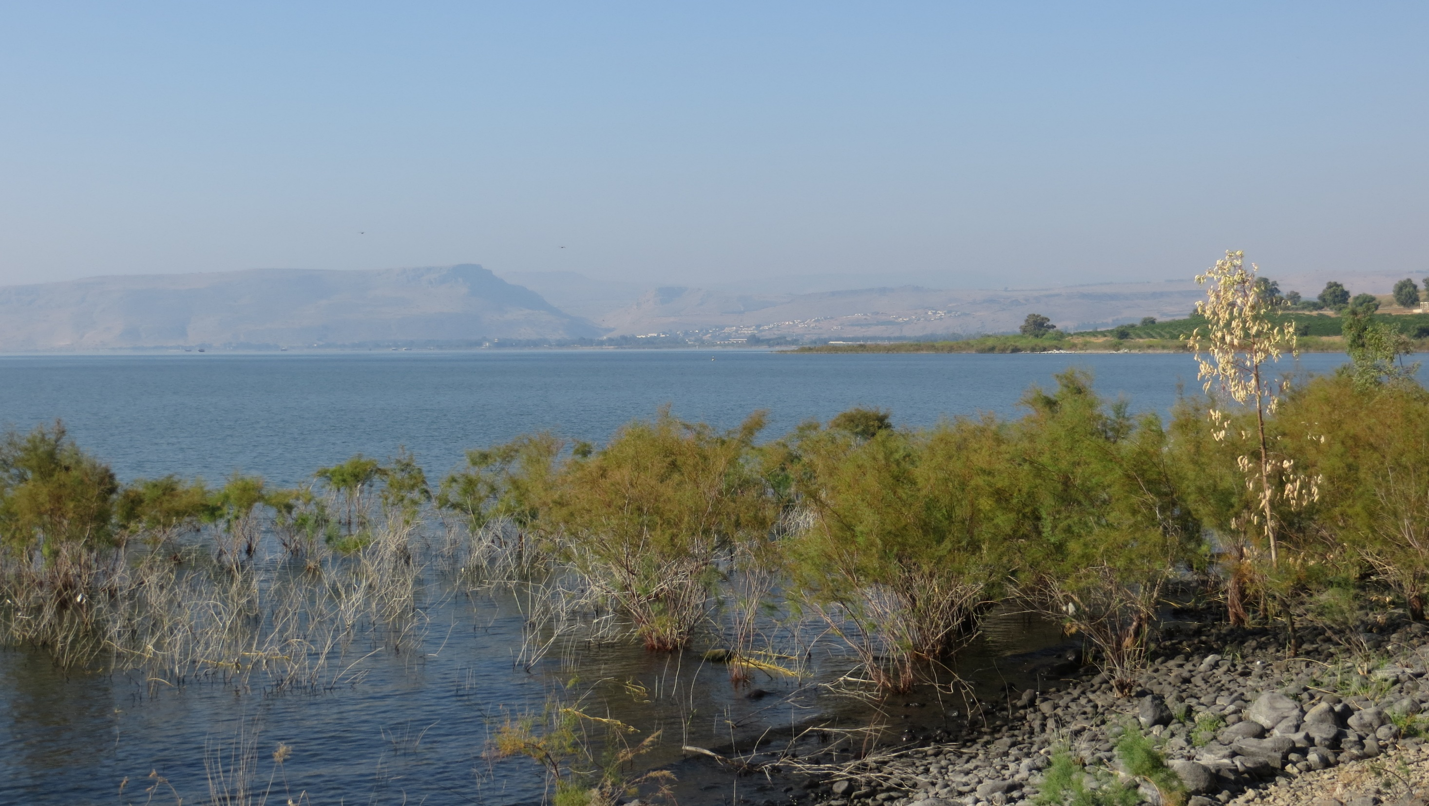
Exploring the concept of mercy in the Bible
Some questions to start us off:
Is our concept too limited?
Is there a tendency to think of God’s mercy as something to beg for?
Does God have to be persuaded to forgive?
…and so on.
In Biblical accounts, God’s mercy is always God’s initiative
Admittedly, there are passages where God is described as a jealous God, quick to anger, repaying the sins of fathers on their children to many generations. These passages illustrate an important but not always realised principle that the biblical texts are inspired, but not always revelatory! Writers were inspired to depict God according to their understanding of the behaviour of powerful human rulers, from whom mercy, release from death, mitigation of sentence could be sought.

Slide 3
God’s mercy cannot to be measured against human standards.
John’s gospel – Jesus’ statement of intent to Nicodemus:
“Yes, God loved the world so much that he gave his only Son,
so that everyone who believes in him may not be lost
but may have eternal life. For God sent his Son into the world, not to condemn the world, but so that through him the world might be saved” (John 3:16-17).

Slide 4
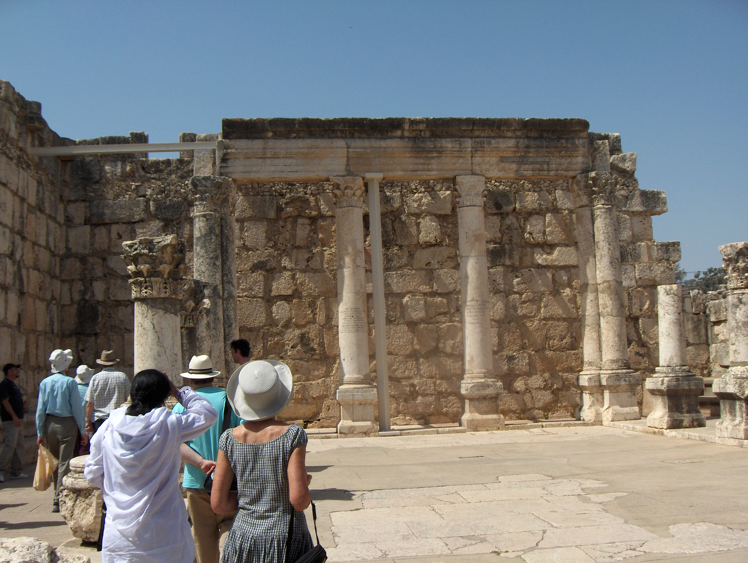
Mark 1:21-31 “Jesus and his followers went as far as Capernaum, and as soon as the sabbath came he went to the synagogue and began to teach. And his teaching made a deep impression on them because, unlike the scribes, he taught them with authority.
In their synagogue just then there was a man possessed by an unclean spirit and it shouted, ‘What do you want with us, Jesus of Nazareth? Have you come to destroy us? I know who you are: the Holy One of God.’ But Jesus said sharply, ‘Be quiet! Come out of him!’ And the unclean spirit threw the man into convulsions and with a loud cry went out of him. The people were so astonished that they started asking each other what it all meant. ‘Here is a teaching that is new’ they said ‘and with authority behind it: he gives orders even to unclean spirits and they obey him.’ And his reputation rapidly spread everywhere, through all the surrounding Galilean countryside.
On leaving the synagogue, Jesus went with James and John straight to the house of Simon and Andrew. Now Simon’s mother-in-law had gone to bed with fever, and they told him about her straightaway. He went to her, took her by the hand and helped her up. And the fever left her and she began to wait on them.

Slide 5
1. With a word, Jesus silences the clamour of evil.
In Genesis 1:1 “…In the beginning…the earth was a formless void, there was darkness over the deep, [connotations of noise and chaos] and God’s spirit hovered over the water.
God said, ‘Let there be light’, and there was light. God saw that light was good, and God divided light from darkness. With repeated words, God introduces order/calm to chaos and noise. When Jesus silences the unclean spirit in the synagogue, people say “here is a TEACHING’ that is new…and with authority”. Jesus’ actions and words are consistent: ‘dabar’ – Hebrew verb for ‘say’ and ‘do’
2. Jesus takes Simon’s mother in laws by the hand and raises her up [connotations of resurrection]. Jesus enhances the quality of life; he does not merely restore it.
3. Jesus’ actions demonstrate and introduce the will of God, the kingdom of God. He is the expression and the reality of God’s mercy.

Slide 6
Luke 7:1-10 “When Jesus had come to the end of all he wanted the people to hear, he went into Capernaum. A centurion there had a servant, a favourite of his, who was sick and near death. Having heard about Jesus he sent some Jewish elders to him to ask him to come and heal his servant. When they came to Jesus they pleaded earnestly with him. ‘He deserves this of you’ they said ‘because he is friendly towards our people; in fact, he is the one who built the synagogue.’ So Jesus went with them, and was not very far from the house when the centurion sent word to him by some friends: ‘Sir,’ he said ‘do not put yourself to trouble; because I am not worthy to have you under my roof; and for this same reason I did not presume to come to you myself; but give the word and let my servant be cured. For I am under authority myself, and have soldiers under me; and I say to one man: Go, and he goes; to another: Come here, and he comes; to my servant: Do this, and he does it.’ When Jesus heard these words he was astonished at him and, turning round, said to the crowd following him, ‘I tell you, not even in Israel have I found faith like this.’ And when the messengers got back to the house they found the servant in perfect health.

Slide 7
Exploring the concept of mercy in the Bible
Biblical accounts, perhaps especially (surprisingly?) the Old Testament, include the most extraordinary insights into God’s mercy. At least some of these passages are found within the context of God’s wrath and the promise of God’s destruction of his faithless people.
A spectacular example of this occurs just as God is prepared to destroy his people for apostasy (the golden calf) while Moses is receiving the Law on Mount Sinai (Exodus 32). In the next chapter, Moses begs God to spare this people, and God promises to do so because God is pleased with Moses.
Then an astonishing thing happens in Exodus 33:8-23…

Slide 8
Exploring the concept of mercy in the Bible
Moses appeals to God:
“Show me your glory” And God said, ‘I will let all my splendour pass in front of you, and I will pronounce before you the name of The Lord…You cannot see my face…for man cannot see me and live…Here is a place beside me…when my glory passes by, I will put you in a cleft of the rock and shield you with my hand while I pass by…(from Ex 33:18-23)
…The Lord passed before him and proclaimed “The Lord, The Lord, A God of tenderness and compassion, slow to anger, rich in kindness and faithfulness; for thousands he maintains his kindness, forgives faults, transgressions, sins… (from Ex 34:6-7)
In our translations various English words are used to convey mercy, compassion, slowness to anger etc., which can be confusing….but Hebrew and Greek also use many and varying words!

Slide 9
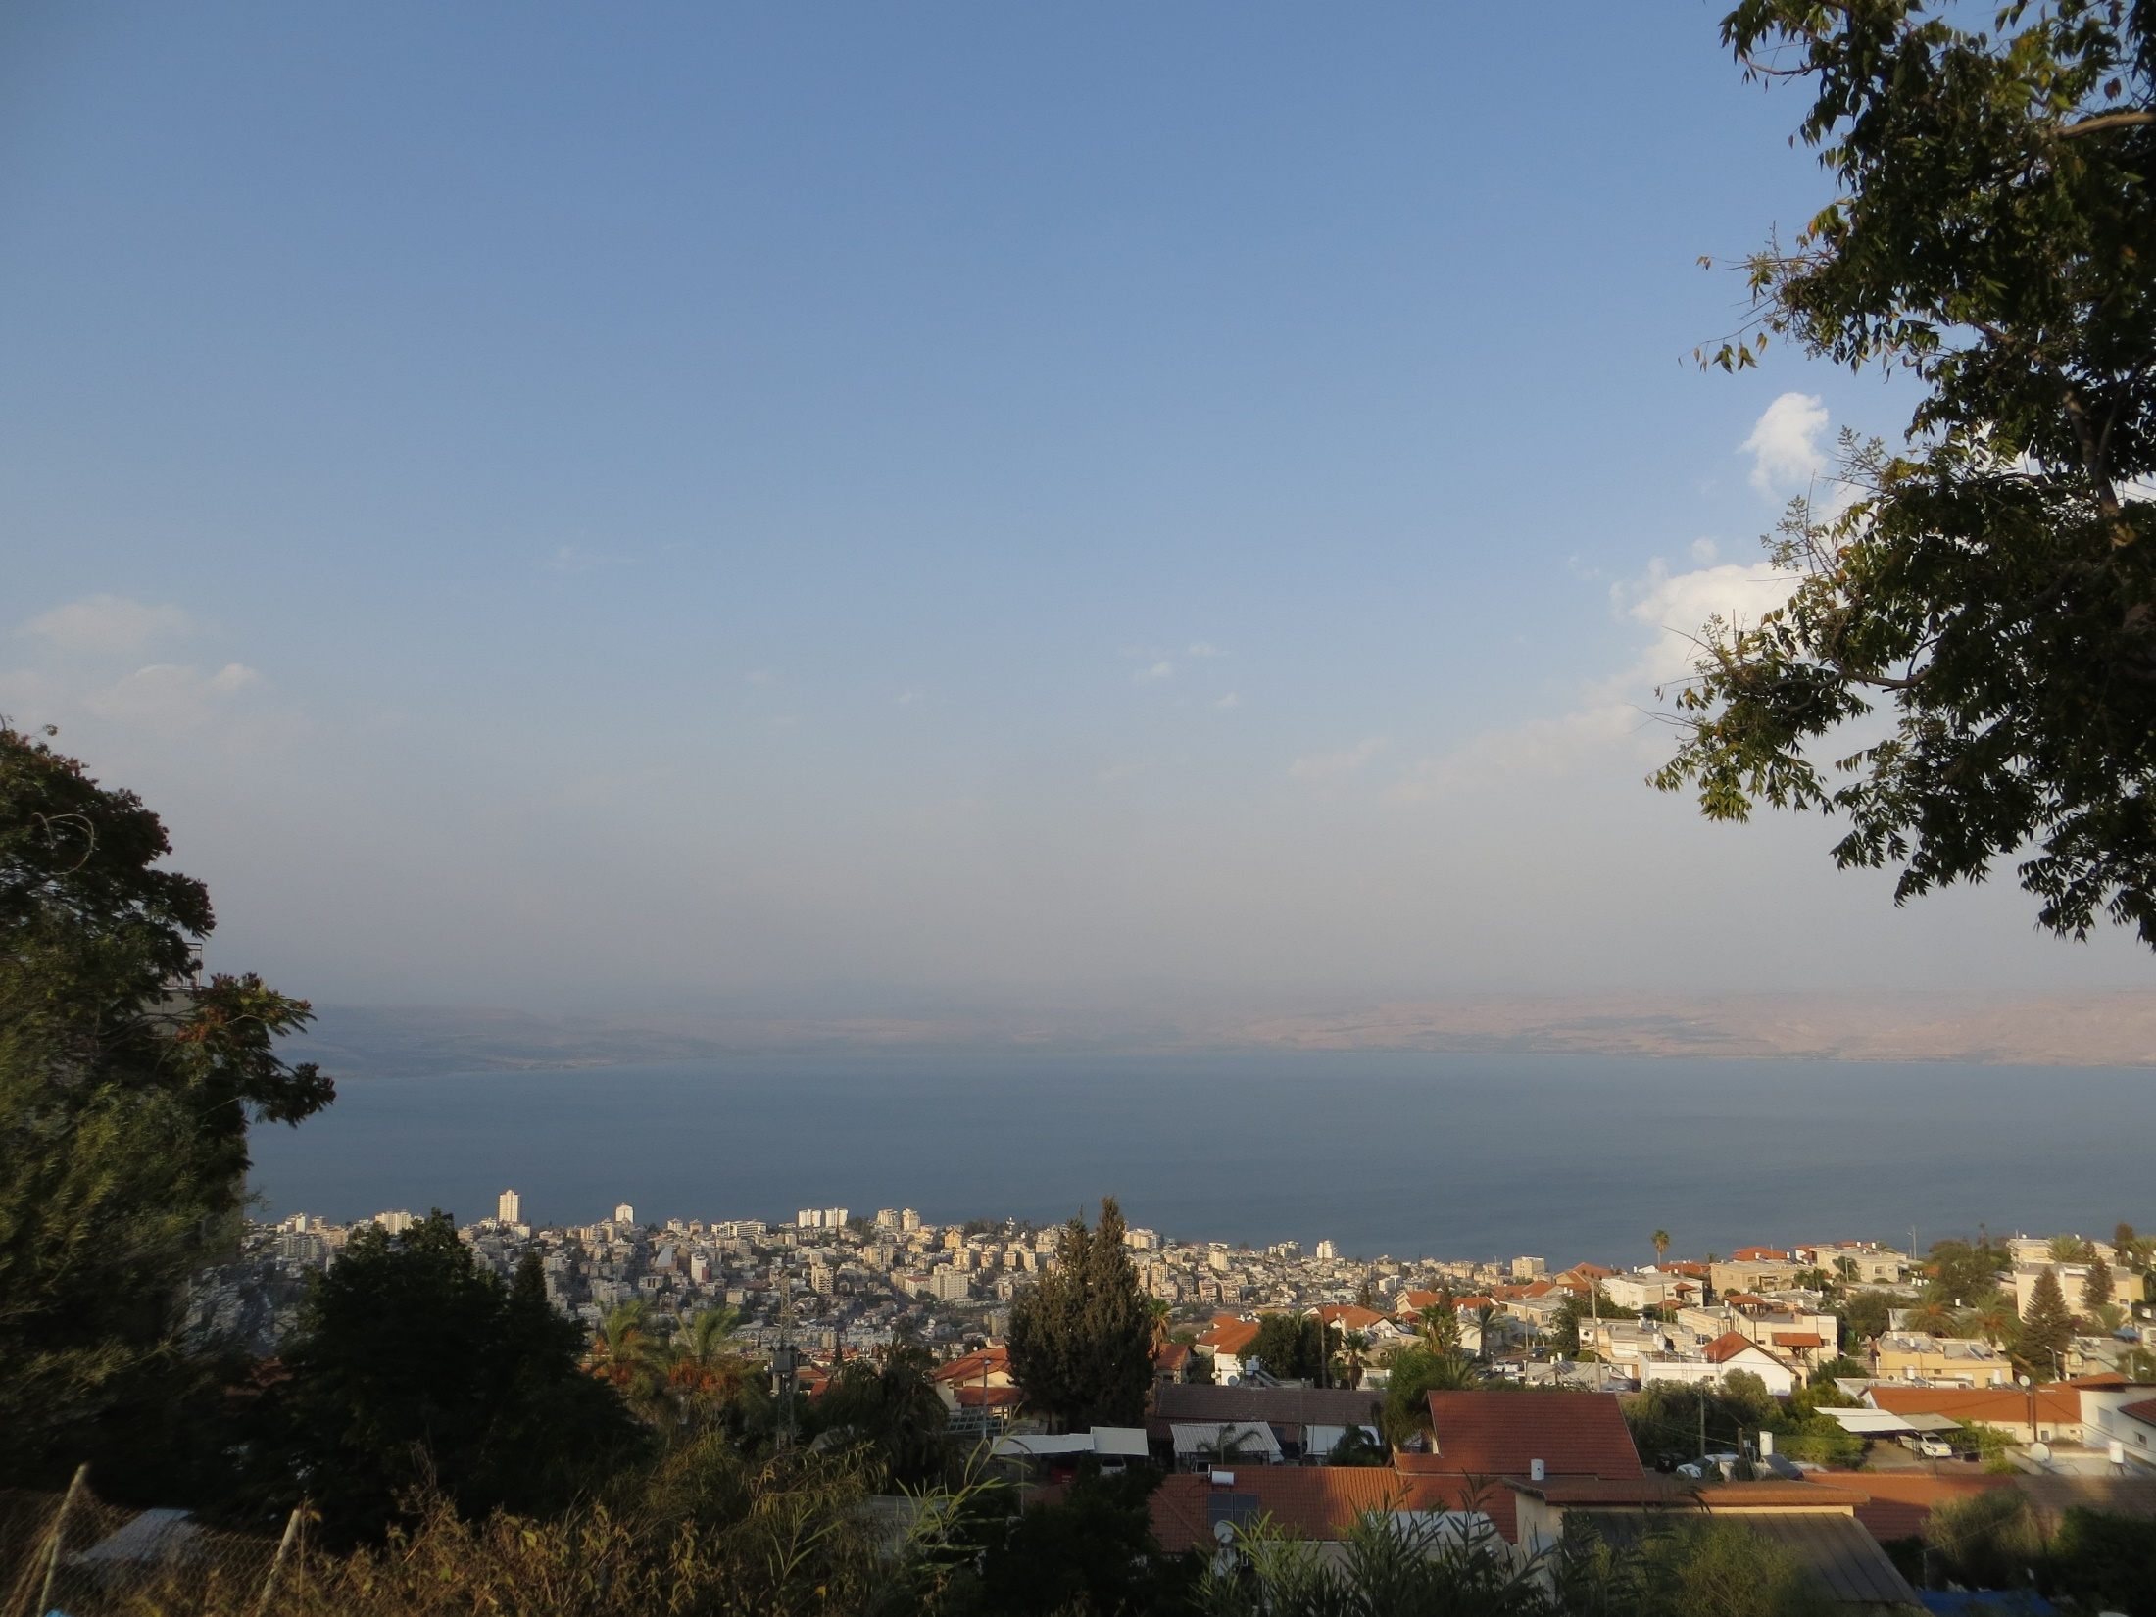
The way words for mercy are interchanged suggests that biblical writers struggled to describe a concept which was alien to human thought and action.
God’s deeds for humanity are unique…
The defining moment for Israel, comes in the liberation of Israel from slavery, and their constitution as God’s people. Before the journey begins however, Moses ‘meets’ God in the burning bush [Exodus 3:7-8, 3rd Sunday of Lent, Year C].
God makes an extraordinary declaration which becomes a divine Mission Statement at several crucial points in the Old Testament, paraphrased here:
‘I have heard the cry of my people in their distress. I mean to respond to their cry’. We are into the realms of divine mercy here: God intends to address the distress of his people. This continues throughout the Biblical narrative, and each time God’s people reject God and end in distress, God increase the effort of outreach.
Ultimately, Jesus is God’s final answer to humanity’s cry of distress. In the context of our theme, Jesus IS God’s mercy
‘Father, forgive them: they don’t know what they’re doing
[Luke 23:34; Palm Sunday Year C]

Slide 10
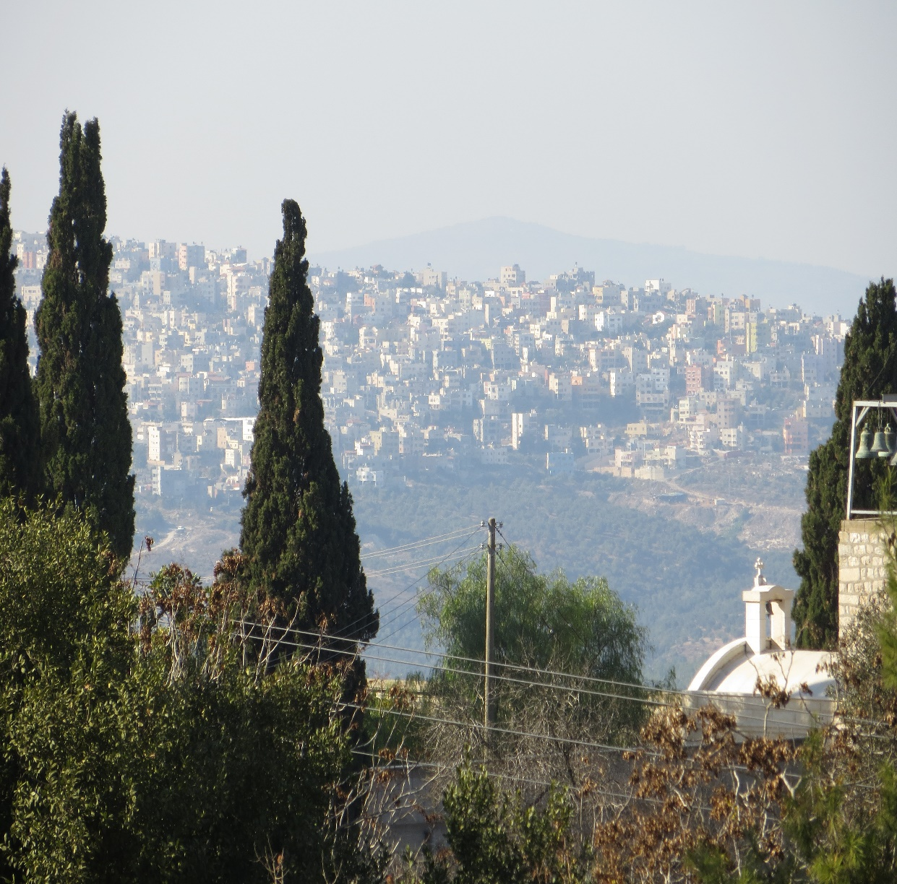
In several places in the Old Testament, there is the occasional ‘outbreak’ of the same tenderness of God:
Hosea 11:1-4,8-9
“When Israel was a child I loved him, and I called my son out of Egypt.
But the more I called to them, the further they went from me; they have offered sacrifice to the Baals…I myself taught Ephraim to walk, I took them in my arms; yet they have not understood that I was the one looking after them. I was like someone who lifts an infant close against his cheek; stooping down to him I gave him his food. Ephraim, how could I part with you? Israel, how could I give you up? My heart recoils from it…I will not give rein to my fierce anger…for I am God, not man… the Holy One in your midst and have no wish to destroy”

Slide 11
Pope Francis uses this passage in the Bull of Indiction for the Holy Year:
On Hosea 11:1-9
“According to human logic, it seems reasonable for God to think of rejecting an unfaithful people. The prophet’s words attest to this: “They shall not return to the land of Egypt, and Assyria shall be their king, because they have refused to return to me” (Hos 11:5). And yet, after this invocation of justice, the prophet radically changes his speech and reveals the true face of God: “How can I give you up, O Ephraim! How can I hand you over, O Israel! …I will not execute my fierce anger, I will not again destroy Ephraim; for I am God and not man, the Holy One in your midst, and I will not come to destroy”.
Saint Augustine says: “It is easier for God to hold back anger than mercy”. And so it is. God’s anger lasts but a moment, his mercy forever. If God limited himself to only justice, he would cease to be God, and would instead be like human beings who ask merely that the law be respected.”

Slide 12
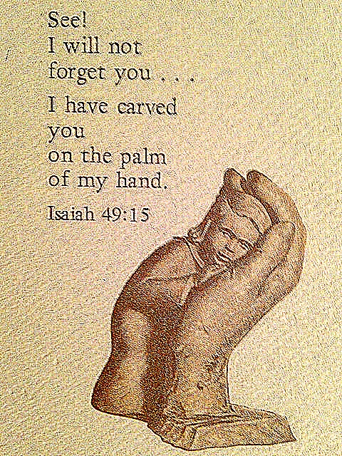
My soul, give thanks to the Lord all my being, bless his holy name. My soul, give thanks to the Lord and never forget all his blessings. It is (the Lord) who crowns you with love and compassion, 8 The Lord is compassion and love, slow to anger and rich in mercy. 9 His wrath will come to an end; he will not be angry for ever. 10 He does not treat us according to our sins nor repay us according to our faults. 12 As far as the east is from the west so far does he remove our sins. Psalm 103(102)
Thus says the Lord: I did forsake you for a brief moment, but with great love will I take you back. In excess of anger, for a moment I hid my face from you. But with everlasting love I have taken pity on you, says the Lord, your redeemer. So now I swear concerning my anger with you and the threats I made against you; for the mountains may depart, the hills be shaken, but my love for you will never leave you and my covenant of peace with you will never be shaken, says the Lord who takes pity on you. [Is 54:5-14 Easter Vigil]
For Zion was saying, ‘The Lord has abandoned me, the Lord has forgotten me.’
Does a woman forget her baby at the breast, or fail to cherish the son of her womb? Yet even if these forget, I will never forget you. [Is 49:14-15, Wednesday, Lent week 4]

Slide 13
Jesus: God’s ultimate answer to the cry of his people’s distress; the ‘I AM’ sayings in John
Famously, at the burning bush, God revealed himself to Moses as “I am who I am” (JB)
“Moses, said to (God), ‘I am to go, then, to the sons of Israel and say to them, “The God of your fathers has sent me to you.” But if they ask me what his name is, what am I to tell them?’ And God said to Moses, ‘I Am who I Am’. [Exodus 3:14; 3 Lent C]
In John, Jesus appropriates the title, sometimes on its own e.g. ‘before Abraham ever was, I AM’ [Jn 8:58; Thur 5 Lent], in which case it serves as a claim to divinity (which is why his opponents tried to stone him for blasphemy). In most cases, the phrase is predicated, so Jesus reveals aspects of the ‘implications’ of his divinity and his ministry. So, he can say: “I AM”…the light of the world; the Bread of Life; the Vine; the Good Shepherd; the Resurrection and the Life, the Way, the Truth and the Life…
These are also expressions of how he reveals God to humanity. AND, they are the revelation of God to humanity.
In Jesus, we have the other side of humanity made in God’s image and likeness; Jesus is God in human image and likeness.
Jesus IS God’s mercy. Jesus is God answering humanity’s distress call by sharing the human condition and redeeming it. In Jesus, the OT expressions we just considered become reality.

Slide 14
Mercy in the gospel of Luke.
The Structure of Luke’s gospel
Luke uses approx. 50% of Mark almost unaltered. Luke uses a great amount of his own material, from the Infancy Narratives and on through much unique material from the journey to Jerusalem (Lk 9:51 – 19:28 [19:12]).
‘Mercy/compassion’ are at least implicitly present throughout the gospel: In the infancy narratives, Zechariah is told of God’s mercy to him and his wife in the shape of a son in answer to their prayers. Zechariah forgets the purpose of his prayer? Mary accepts God’s mercy (salvation) on behalf of humanity, and sings “[God’s] mercy reaches from age to age for those who fear him (Lk 1:50)…He has come to the help of Israel his servant, mindful of his mercy…to Abraham and to his descendants…’ (Lk 1:54). On regaining his voice, Zechariah asserts that God shows the mercy promised to ‘our ancestors’ (Lk 1:72). [19, 22, 24 Dec (morning)].
The angel of the Lord announces to shepherds “Today…a saviour has been born to you; he is Christ the Lord”. The angel offers a sign whose fulfilment can easily be established – God’s mercy is assured; the sign confirms the message. (Lk 2:11-16). [Midnight Mass]

Slide 15
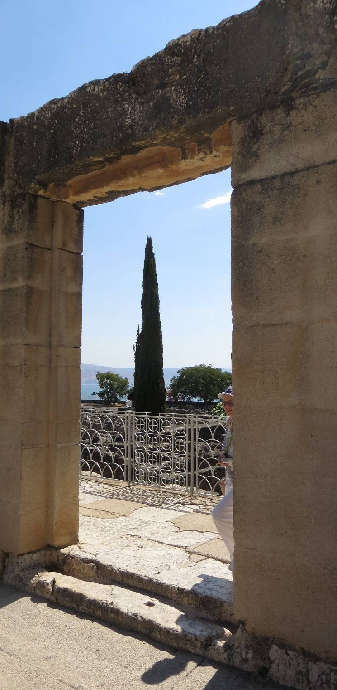
The early ministry of Jesus
No explicit mention of mercy, but the choice of passage sets an agenda for God’s mercy. From Isaiah 61:1; 58:6; 61:2, Jesus cites, fulfils and makes a new prophetic statement of Good News for the poor [Lk 4:18-19; Sundays 3,4C].
When Peter asks Jesus to depart from him because he is a sinful man, Jesus tells him not to fear; not only does Jesus offer sinful Peter God’s mercy: he finds a job for him [5:1-11; 5C].
Luke’s beatitudes are expressions of God’s mercy already extended to the poor, the hungry and those who weep. Alas, though, for the rich, well-fed and those with plenty to laugh about. [6:20-25. 6C – ‘lost’ in Lent/Easter in 2016].
God’s mercy requires that we act like God to others: “be compassionate as your Father is compassionate” [6:36; 7C ‘lost’ in Lent/Easter in 2016]

Slide 16
How do we be compassionate as God is compassionate?
To be like God is to be holy, since God alone is holy. Leviticus 19:2, “Be holy, for I, the Lord your God, am holy” and Lev 19:18b, “You must love your neighbour as yourself”. [Monday Lent week 1]. Love of neighbour = compassion = the way to be holy as God is holy.
Cue for a parable, the first of the uniquely Lukan parables, the Good Samaritan [Lk 10:25-37 Sun 15C]. Famously, the ‘neighbour’ i.e. the compassionate/merciful one uses his own resources for the benefit of someone in need. Others justify themselves for not doing so. The lawyer who asks Jesus what he must do to inherit eternal life is anxious to justify himself. His question: to justify regarding someone as NOT neighbour.
For the record the story of Martha and Mary immediately follows. Martha tries to justify herself for not listening to Jesus.

Slide 17
Some instances where Jesus displays God’s mercy
ACTIONS in ch. 7, Sun 9,10,11 C.
Lk 7:1-10. Cure of the centurion’s servant. The Jews want Jesus to cure the man because the centurion ‘deserves it’; Jesus cures because he is merciful/compassionate
Lk 7:11-17 The widow at Nain. Jesus shows compassion for the widow who lost her only son, and has no means of support.
Lk 7:36-8:3 In the house of Simon the Pharisee, the compassion of forgiveness to the woman ‘with a bad name in the town’.
TEACHING Sundays 17, 22, 24
Lk 11:1-13. Prayer to the Father who is compassionate. No parent would trick a child with something that looked good, but would cause harm (stone instead of bread etc). How much more reliable then must God be?
Lk 14:1. 7-14. The compassion that not only turns against the convention of seeking social status, but which reaches out to the most marginalised (poor, crippled, lame, blind) who cannot return the favour. This is what God does for humanity!
Lk 15. Three parables about the irresponsibility of God the compassionate, and the contrast with the religion of those who do not feel God’s unconditional love.

Slide 18
More teachings!
Lk 16:1-13. (Sun 25) The compassionate Jesus who can admire the dedication and ruthlessness of a corrupt servant, and who can wish ‘the children of light’ would display the same commitment to the gospel (the sequel to the Prodigal Son).
Lk 16:19-31 (Sun 26) The rich man and Lazarus; the arrogance of the rich man even beyond life: still unable to offer compassion, still wanting Lazarus to run errands for him.
Lk 17:11-19 (Sun 28) Jesus shows compassion to 10 lepers. All 10 have faith enough to carry out Jesus’ instruction to show themselves to the priest BEFORE they have been cured. Only one, the Samaritan, acknowledges God’s mercy/compassion. Jesus promises his faith has saved him, i.e. made him complete.
Lk 18:1-8 (Sun 29) The widow and the corrupt judge. The argument here is the same as in Lk 11:1-13. If corrupt humans can do the right thing, even if for the wrong reasons, how much more can God be trusted to see justice done for his children. Interesting footnote: “when the Son of Man comes will he find any faith on earth?” Could this be faith in the mercy of God?

Slide 19
And even more…
Lk 18:9-14 (Sun 30 C) The Pharisee and the tax collector in the Temple. God hears and responds to the prayer of the sinner, because the Pharisee prays to himself!
Lk 19:1-10 (Sun 31 C). Zacchaeus. Was he a sinner? He was presumed to be such by his fellow Israelites (including disciples). Yet Zacchaeus address Jesus in the present tense “If I Discover I have cheated someone, I pay back fourfold the amount. I give half of my money to the poor”. The Son of Man came to seek out and save what was lost. Zacchaeus lost out on the mercy/compassion of his fellow Jews!
Lk 23:35-43 Christ the King. The ultimate expression of the mercy of God occurs when Jesus addresses the man who asks “remember when you come into your kingdom”. The reply, famously, is “today you will be with me in paradise”. As is so often the case in Lk, this man is compared and contrasted with his companion whose demand is for his own self-preservation “save yourself, and us as well!” This devastatingly direct but brief episode needs to be read alongside Jesus’ words as he is nailed to the cross “Father, forgive them; they do not know what they are doing” (Lk 23:34). The ultimate expression of what is meant by God’s mercy?

